Slide 1

Lecture 9 Cyber Security Essentials 20CYS114
-Saurabh Shrivastava
TIFAC Core in Cyber Security
Amrita Vishwa Vidyapeetham

Slide 2
Application Lifecycle
Design
Development
Testing
Maintenance

Slide 3
Security Testing
OWASP Top 10
CWE Top 25
SANS 20
18 CIS Controls
Top 20 CIS Critical Controls

Slide 4
OWASP Top 10
Injection
Broken Authentication
Sensitive Data Exposure
XML External Entities
Broken Access Control
Security Misconfiguration
Cross-Site Scripting (XSS)
Insecure Deserialization
Using Components with known Vulnerability
Insufficient Logging and Monitoring

Slide 5
SQL Injection
A SQL injection attack consists of insertion or “injection” of a SQL query via the input data from the client to the application.
SQL injection attacks are a type of injection attack, in which SQL commands are injected into data-plane input in order to affect the execution of predefined SQL commands.

Slide 6
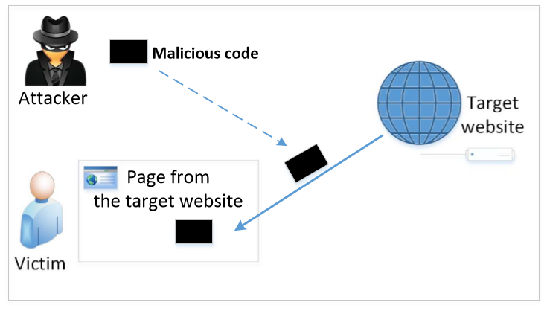
The Cross-Site Scripting Attack
In XSS, an attacker injects his/her malicious code to the victim’s browser via the target website.
When code comes from a website, it is considered as trusted with respect to the website, so it can access and change the content on the pages, read cookies belonging to the website and sending out requests on behalf of the user.

Slide 7
References:
https://www.ibm.com/docs/en/zos-basic-skills?topic=zos-application-development-life-cycle-overview
https://owasp.org/www-project-top-ten/
https://cwe.mitre.org/top25/archive/2020/2020_cwe_top25.html
https://www.cm-alliance.com/consultancy/compliance-gap-analysis/sans-top-20-controls/
https://www.cisecurity.org/controls/cis-controls-list/
https://blog.netwrix.com/2018/02/01/top-20-critical-security-controls-for-effective-cyber-defense/
https://portswigger.net/web-security

